Slide 1
OSMIUM
Xun Liu 09-19-2018

Slide 2




Problem set
Challenge
40 ~ 80 millions of Roads
HERE XML size = 300GB ~ 500GB

Slide 3
Target
Count elements
Filter tags
Build Graph

Slide 5
Problem set
- Suppose there are 40 million of roads, how do you design data schema to hold that in a compression & processing friendly way
- Suppose there is a large trunk of data(over 50GB), how to design proper structure to process
- How to make full use of your hardware to maximize processing speed
- How to keep processing sequence in original
- How to reduce the frequency of memory allocation and deallocation

Slide 6
Agenda
WHAT IS PBF
OSMIUM ARCHICTURE
CODE

Slide 7
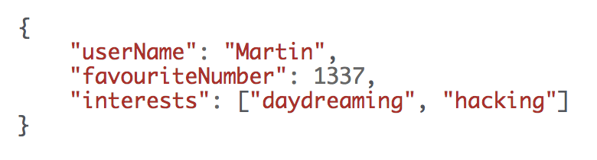
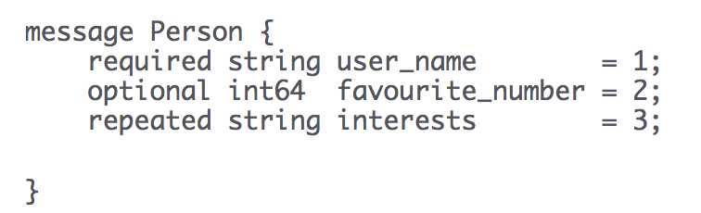
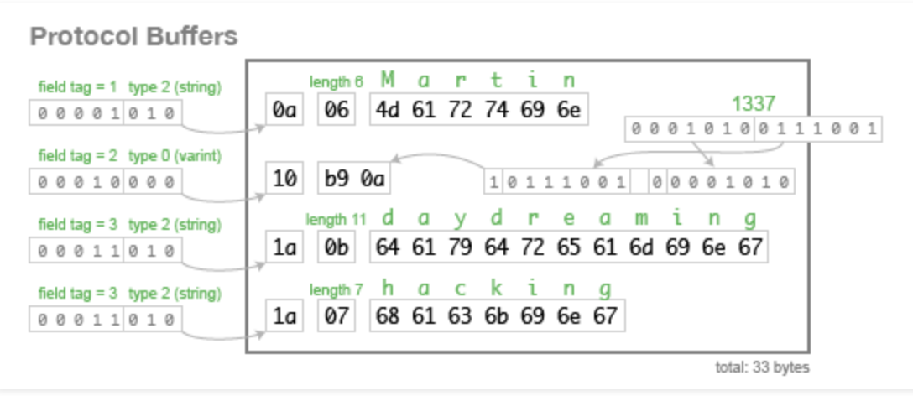
GOOGLE Protobuf

Slide 8
What is OSM-PBF
Node
Way
Relation

Slide 9
Node
<node id="5599384" visible="true"
timestamp="2009-03-18T17:16:26Z" user="burts" uid="97529" lat="51.0271601" lon="13.7252197"/>

Slide 10
Way
<way id="4428564" visible="true" version="21" timestamp="2014-10-14T04:09:13Z" user="Seandebasti" uid="550560">
<nd ref="5599381"/>
<nd ref="2056871900"/>
<nd ref="252587568"/>
<nd ref="250996316"/>
<nd ref="5599384"/>
<tag k="highway" v="residential"/>
<tag k="lit" v="yes"/>
<tag k="maxspeed" v="30"/>
<tag k="name" v="Helmholtzstraße"/>
<tag k="postal_code" v="01069"/>
<tag k="sidewalk" v="both"/>
<tag k="smoothness" v="good"/>
<tag k="surface" v="asphalt"/>
</way>

Slide 11
<relation id="701900" version="1" timestamp="2014-01-01T00:00:00Z" uid="1" user=”bahama" >
<member type="way" ref="701800" role="outer"/>
<member type="way" ref="701801" role="outer"/>
<tag k="type" v="multipolygon"/>
<tag k="test:section" v="mp-geom"/>
<tag k="landuse" v="forest"/>
</relation>
<way id="701800" version="1" timestamp="2014-01-01T00:00:00Z" uid="1" user="test" changeset="1">
<nd ref="701000"/>
<nd ref="701001"/>
<nd ref="701002"/>
<tag k="test:section" v="mp-geom"/>
<tag k="test:id" v="701"/>
</way>
<way id="701801" version="1" timestamp="2014-01-01T00:00:00Z" uid="1" user="test" changeset="1">
<nd ref="701002"/>
<nd ref="701003"/>
<nd ref="701000"/>
<tag k="test:section" v="mp-geom"/>
<tag k="test:id" v="701"/>
</way>

Slide 12
Data Schema
Map data could be represented by
Unique id
type
Key words
Tags

Slide 13
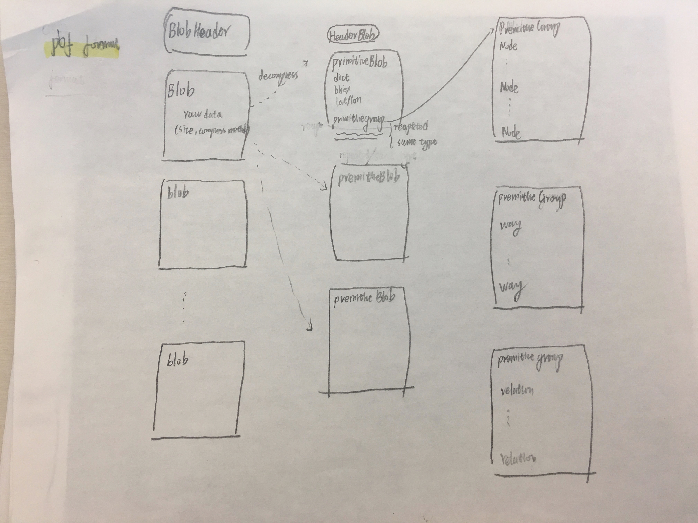
Data Schema

Slide 14
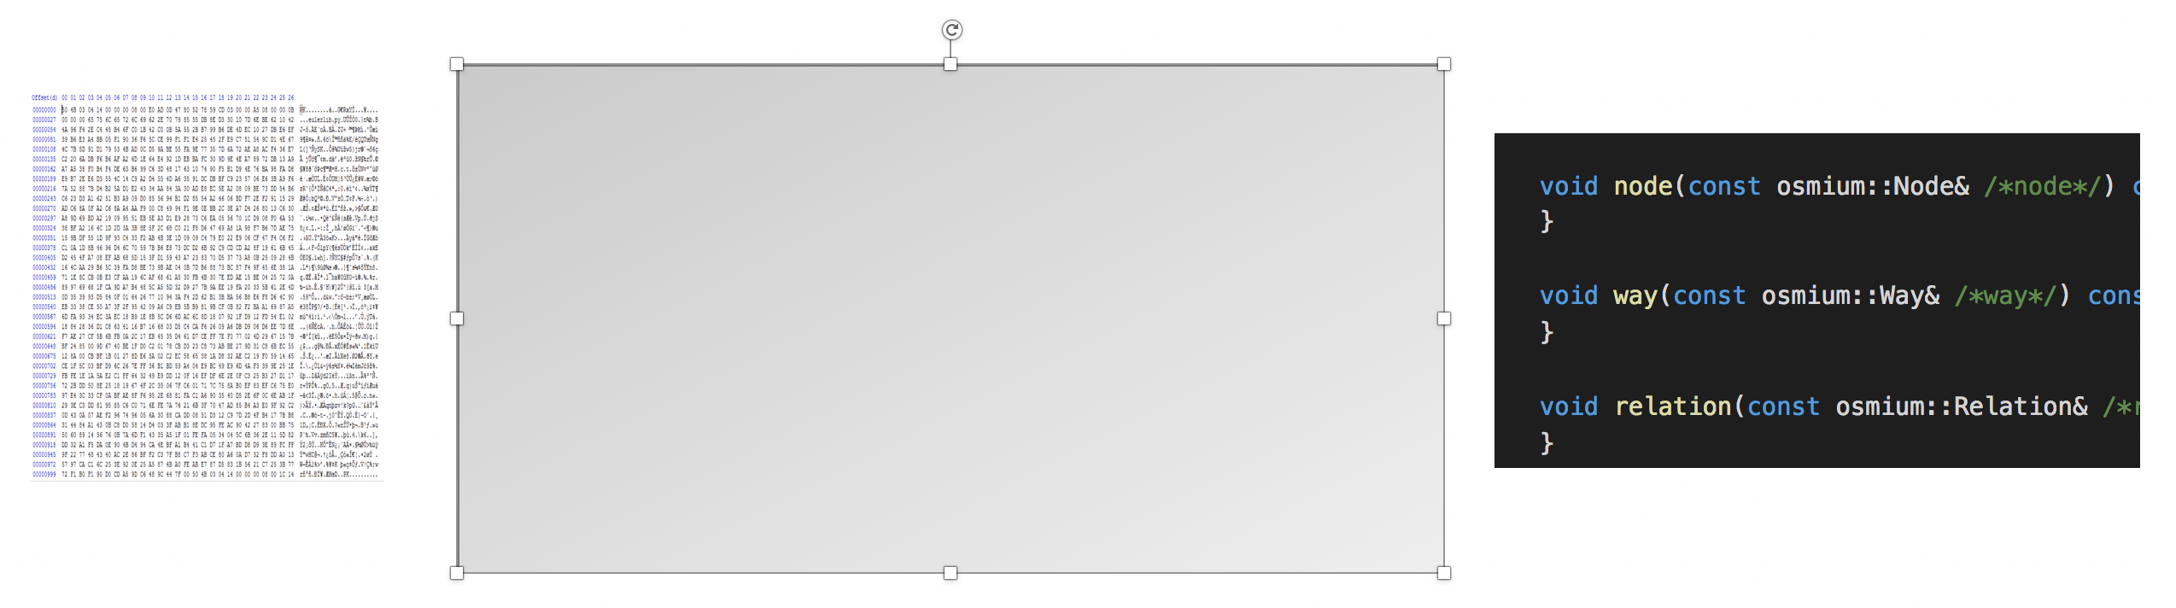
What’s the talk for

Slide 15
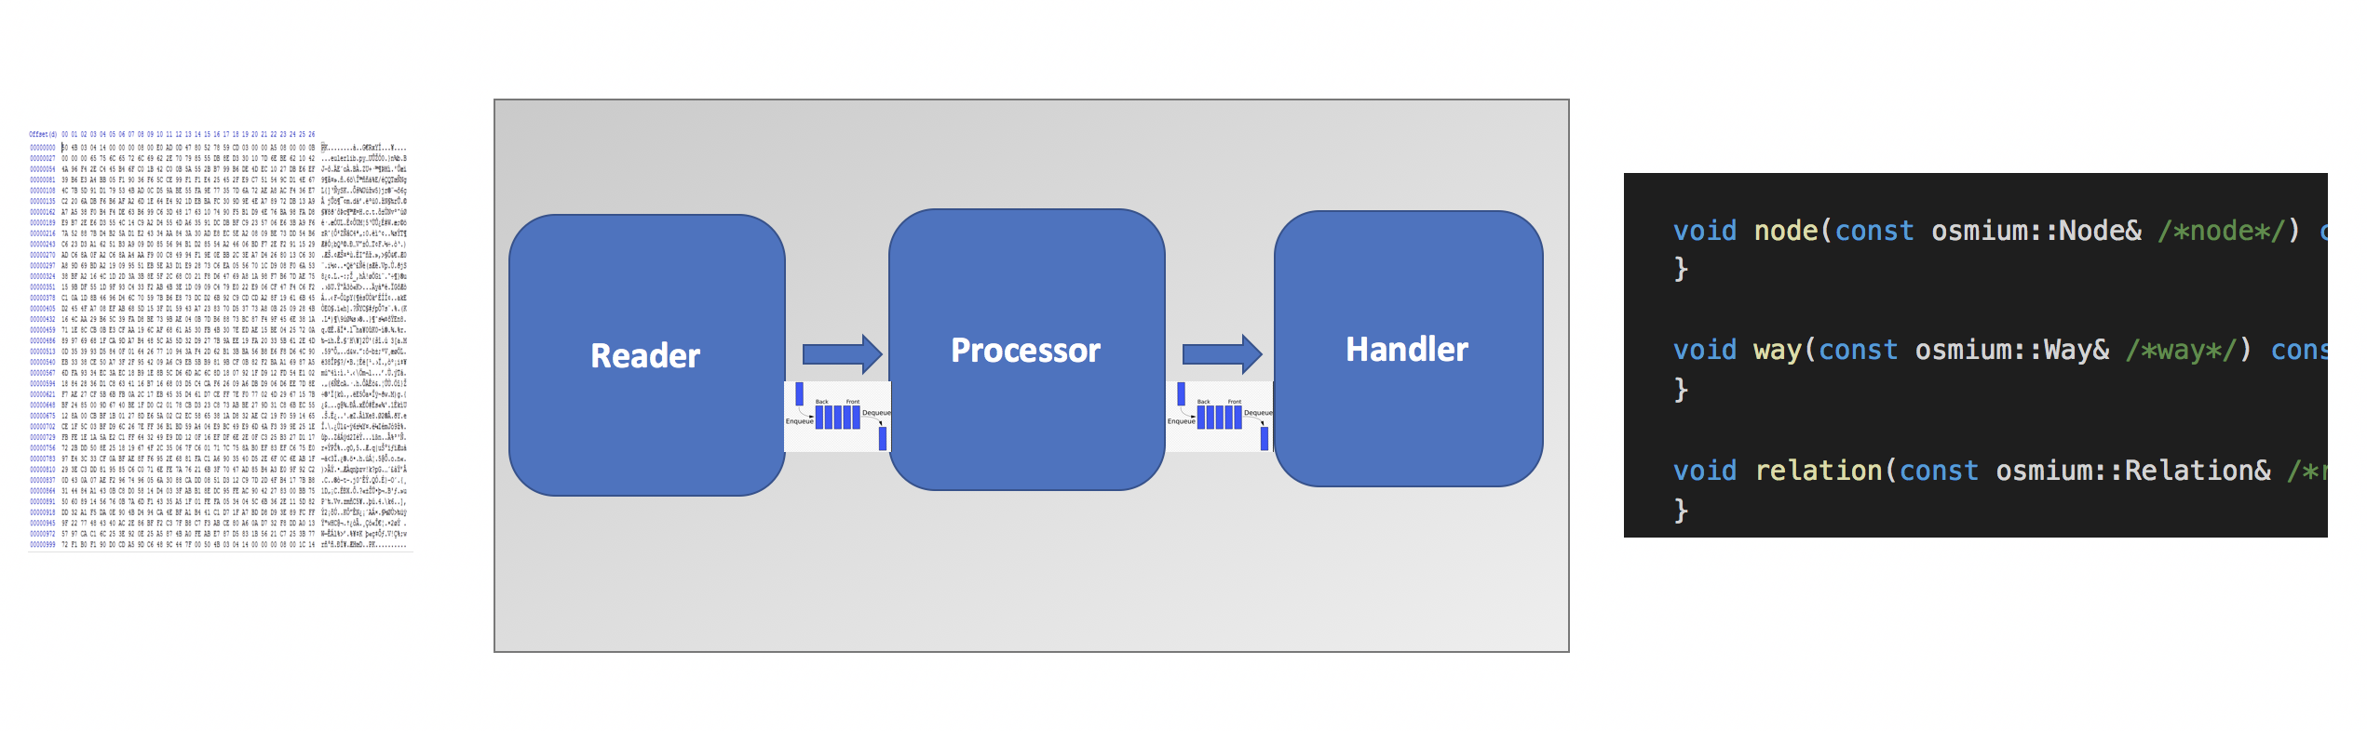
What’s the talk for

Slide 16

reader
One separate thread to read file by fixed buffer or depend on compression unit
(format unaware)
Put result in
thread::Queue<std::future<std::string>>

Slide 17
Important structure
Thread safe queue
Why future

Slide 18
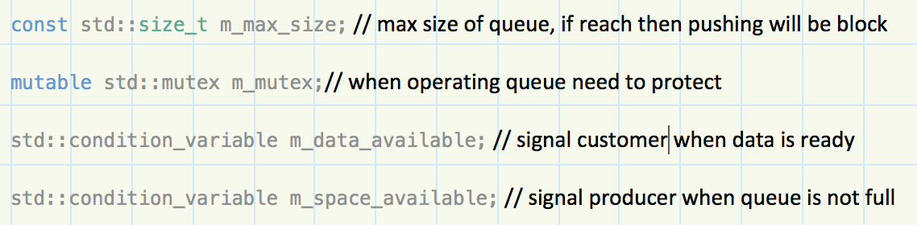
Thread safe queue

Slide 19
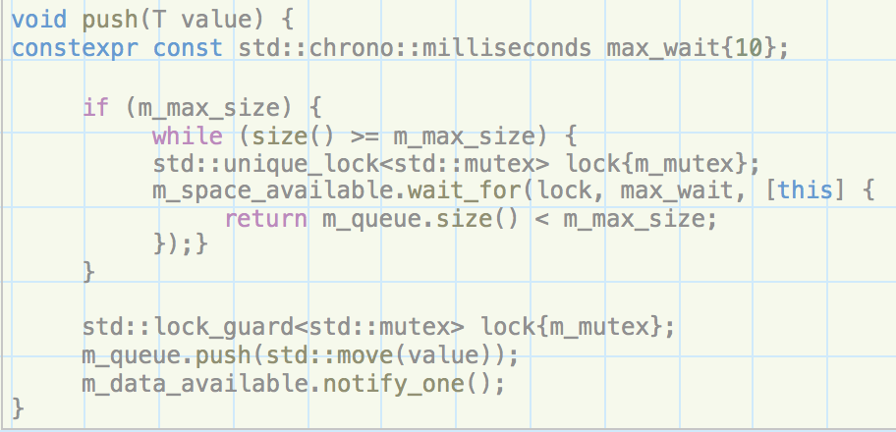
Push

Slide 20
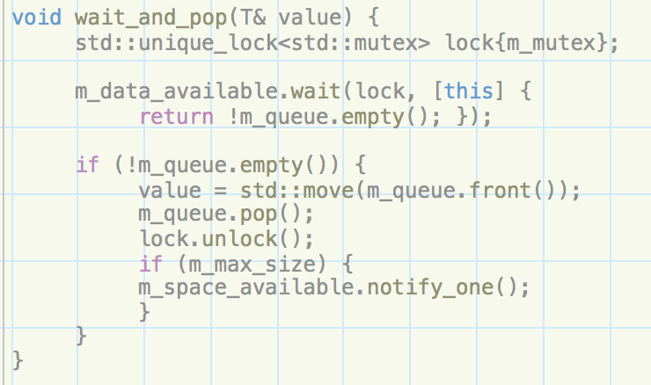
pop

Slide 21
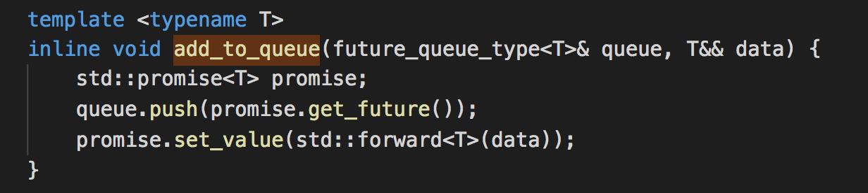
wrapper

Slide 22
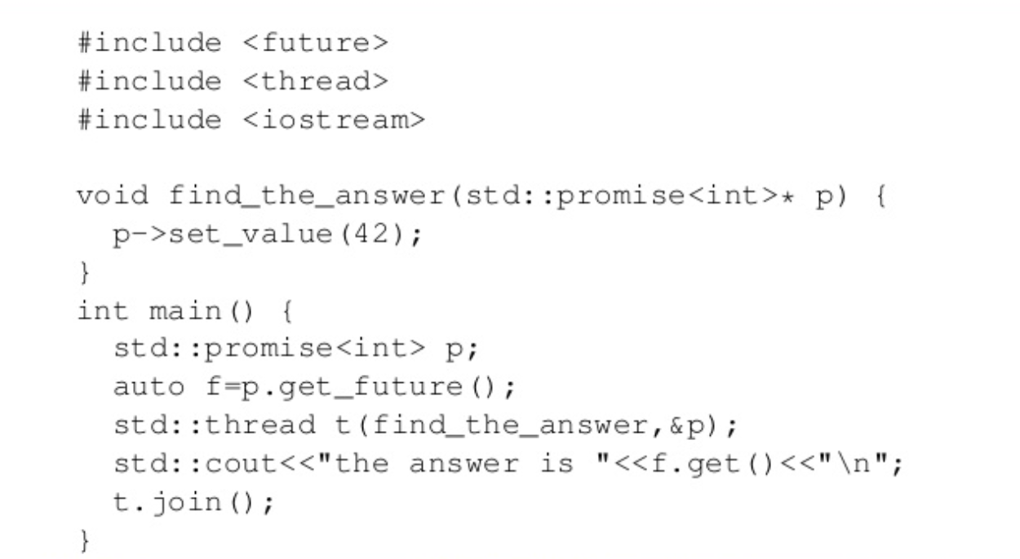
What is Std::future

Slide 23
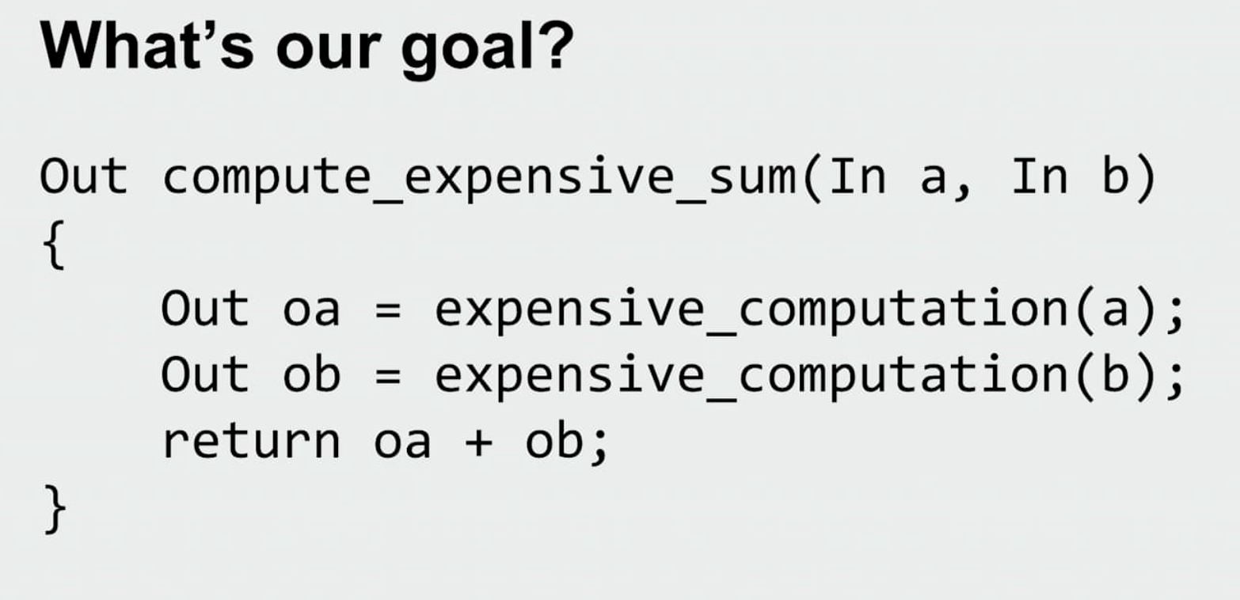
Why future

Slide 24

story

Slide 25
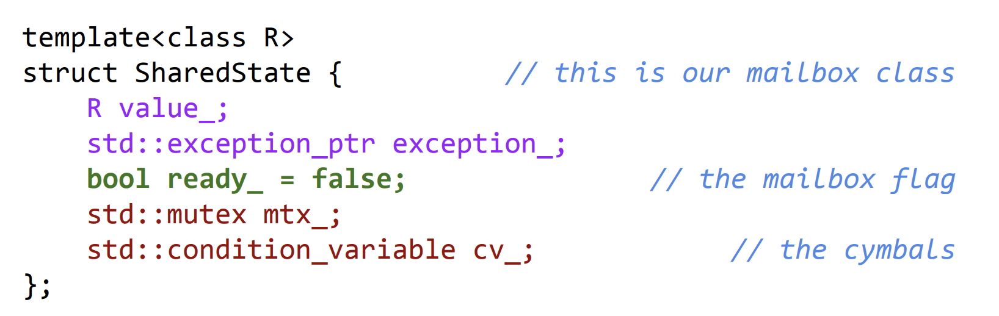
How to implement future

Slide 26
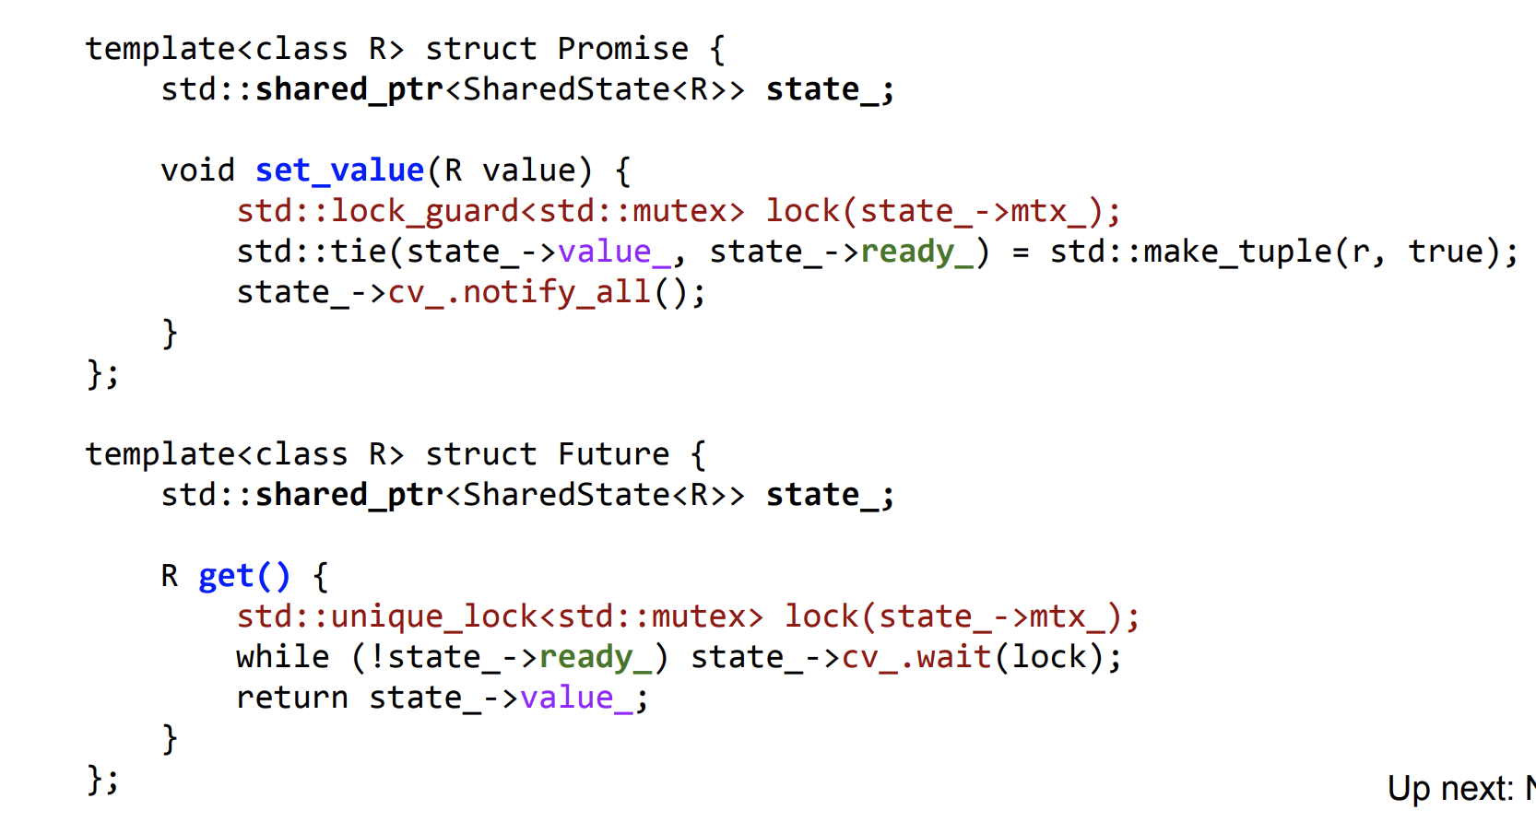

Slide 27
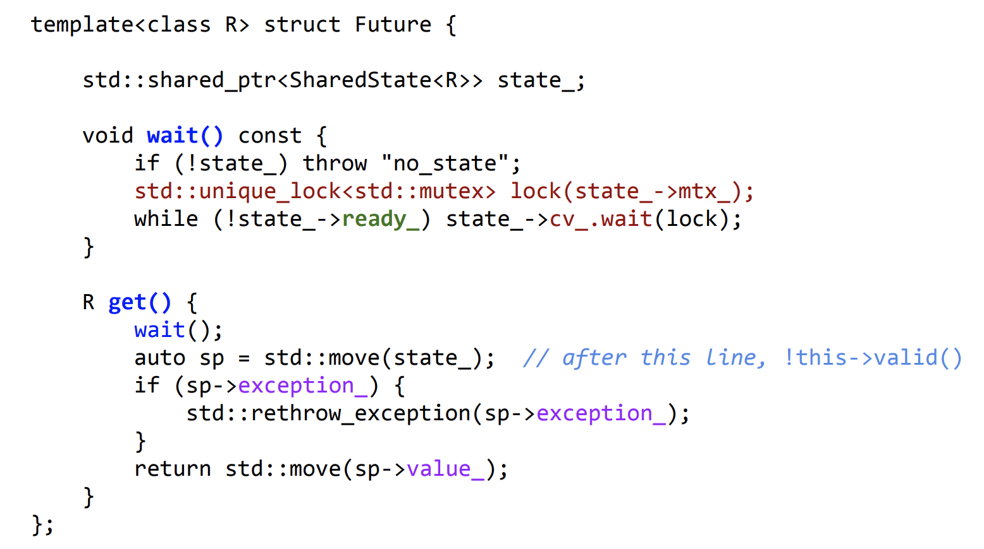

Slide 28
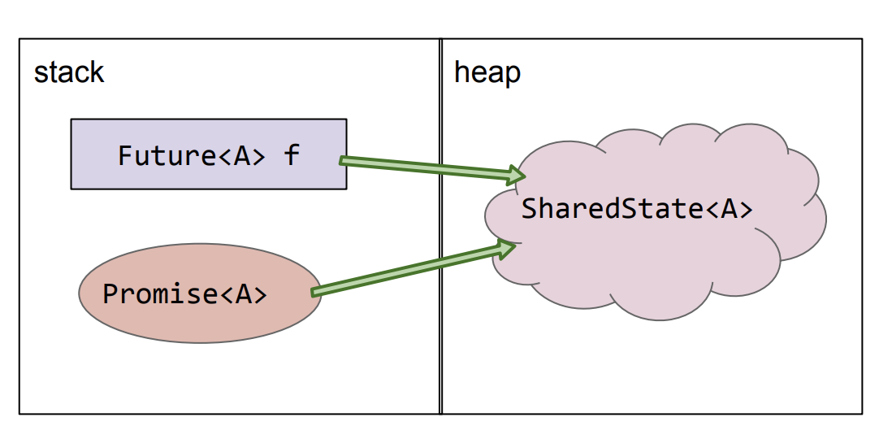

Slide 29
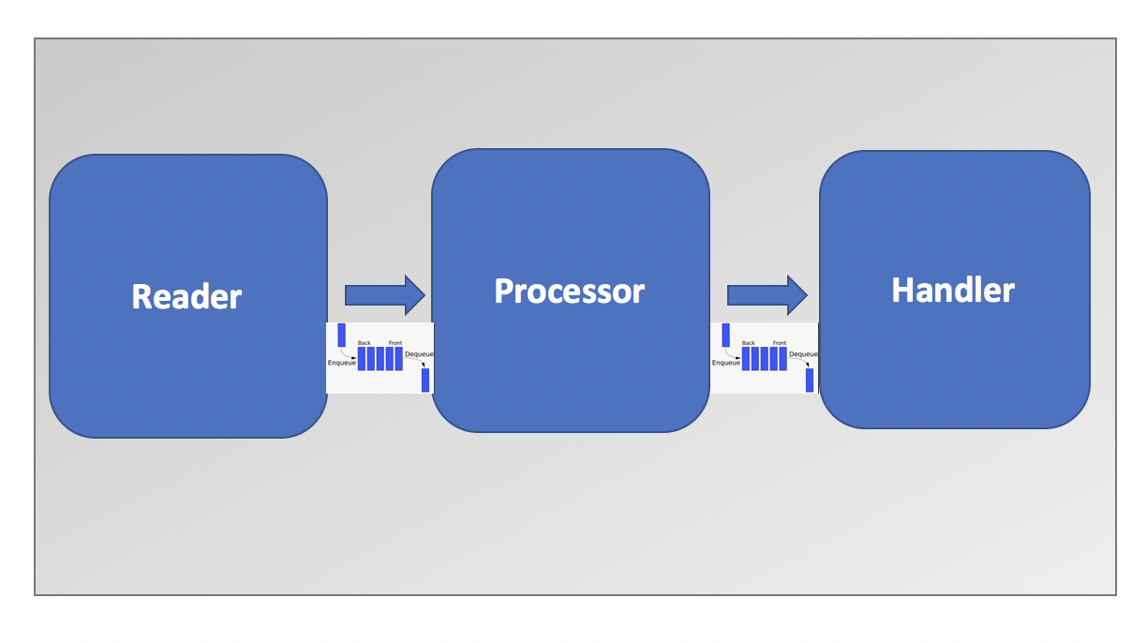

Slide 30

processor
Cut blob data from string queue and
put <data, decoder> as a task in Thread pool
Output is
osmium::thread::Queue<std::future<Buffer>>

Slide 31
Important structure
Thread pool
Buffer

Slide 32
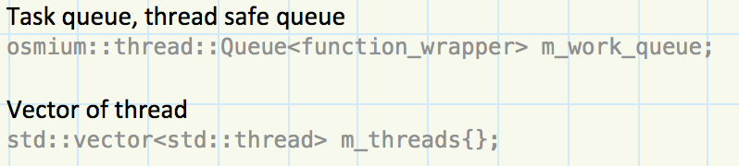
Important design

Slide 33
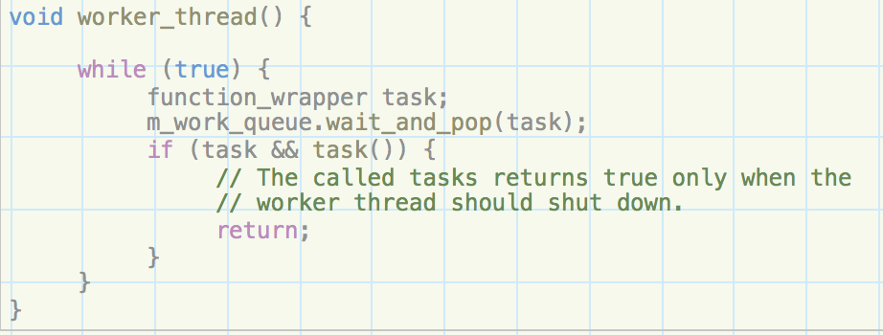

Slide 34
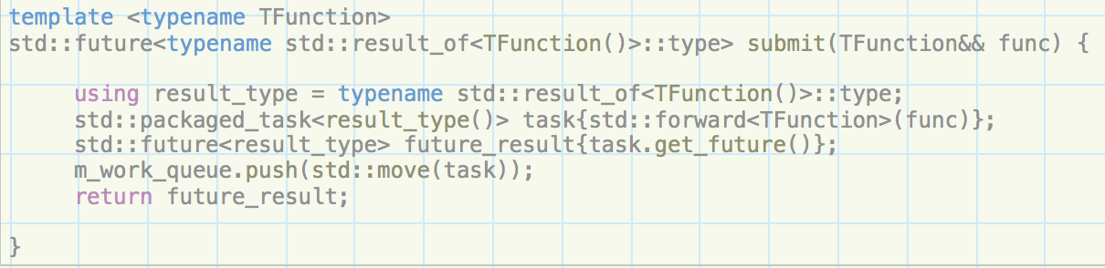

Slide 35
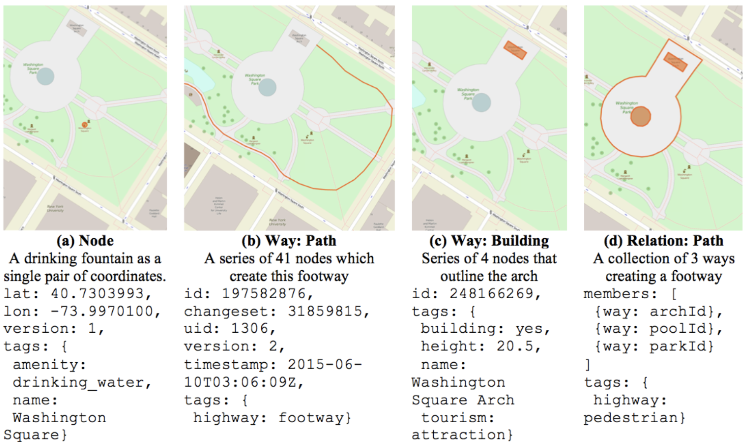
Why buffer

Slide 36
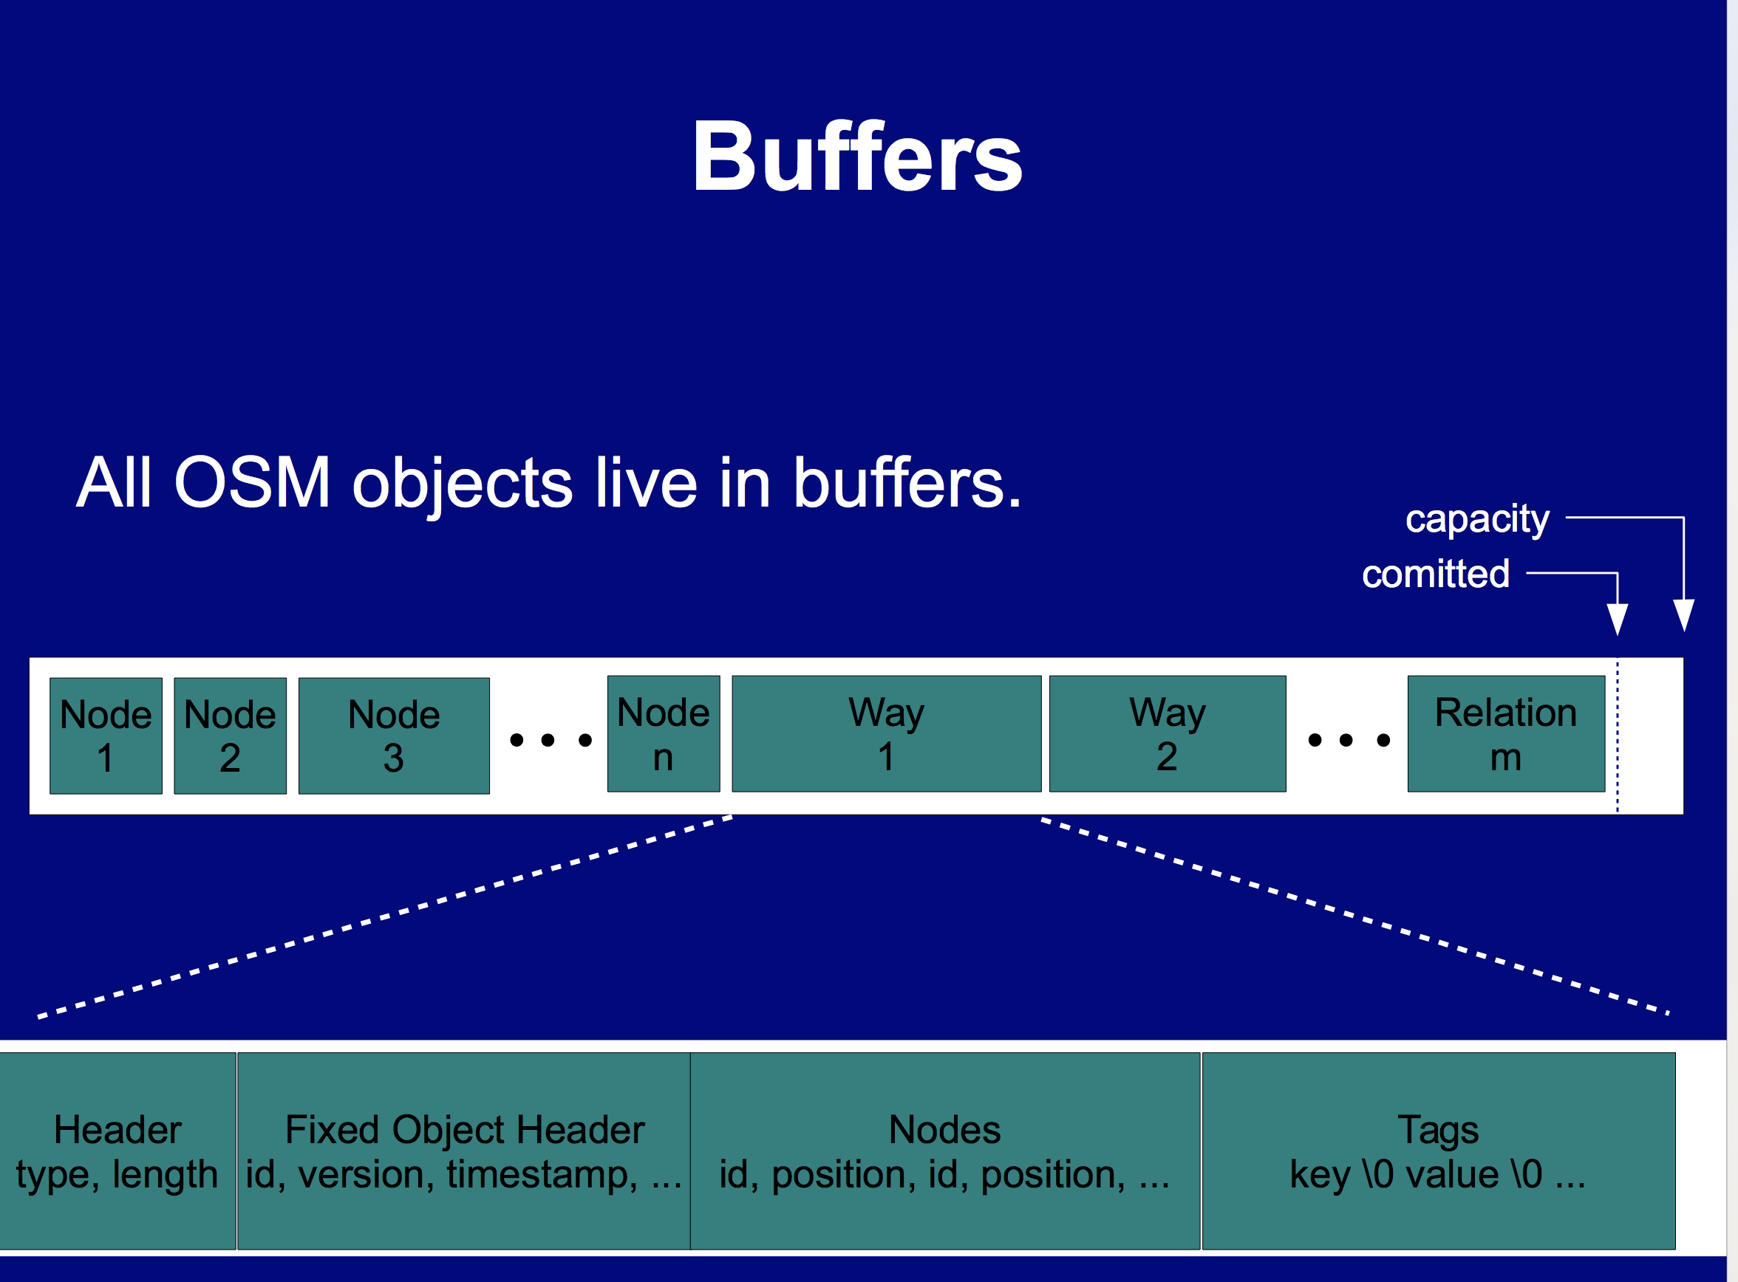
Thread pool
Buffer

Slide 37
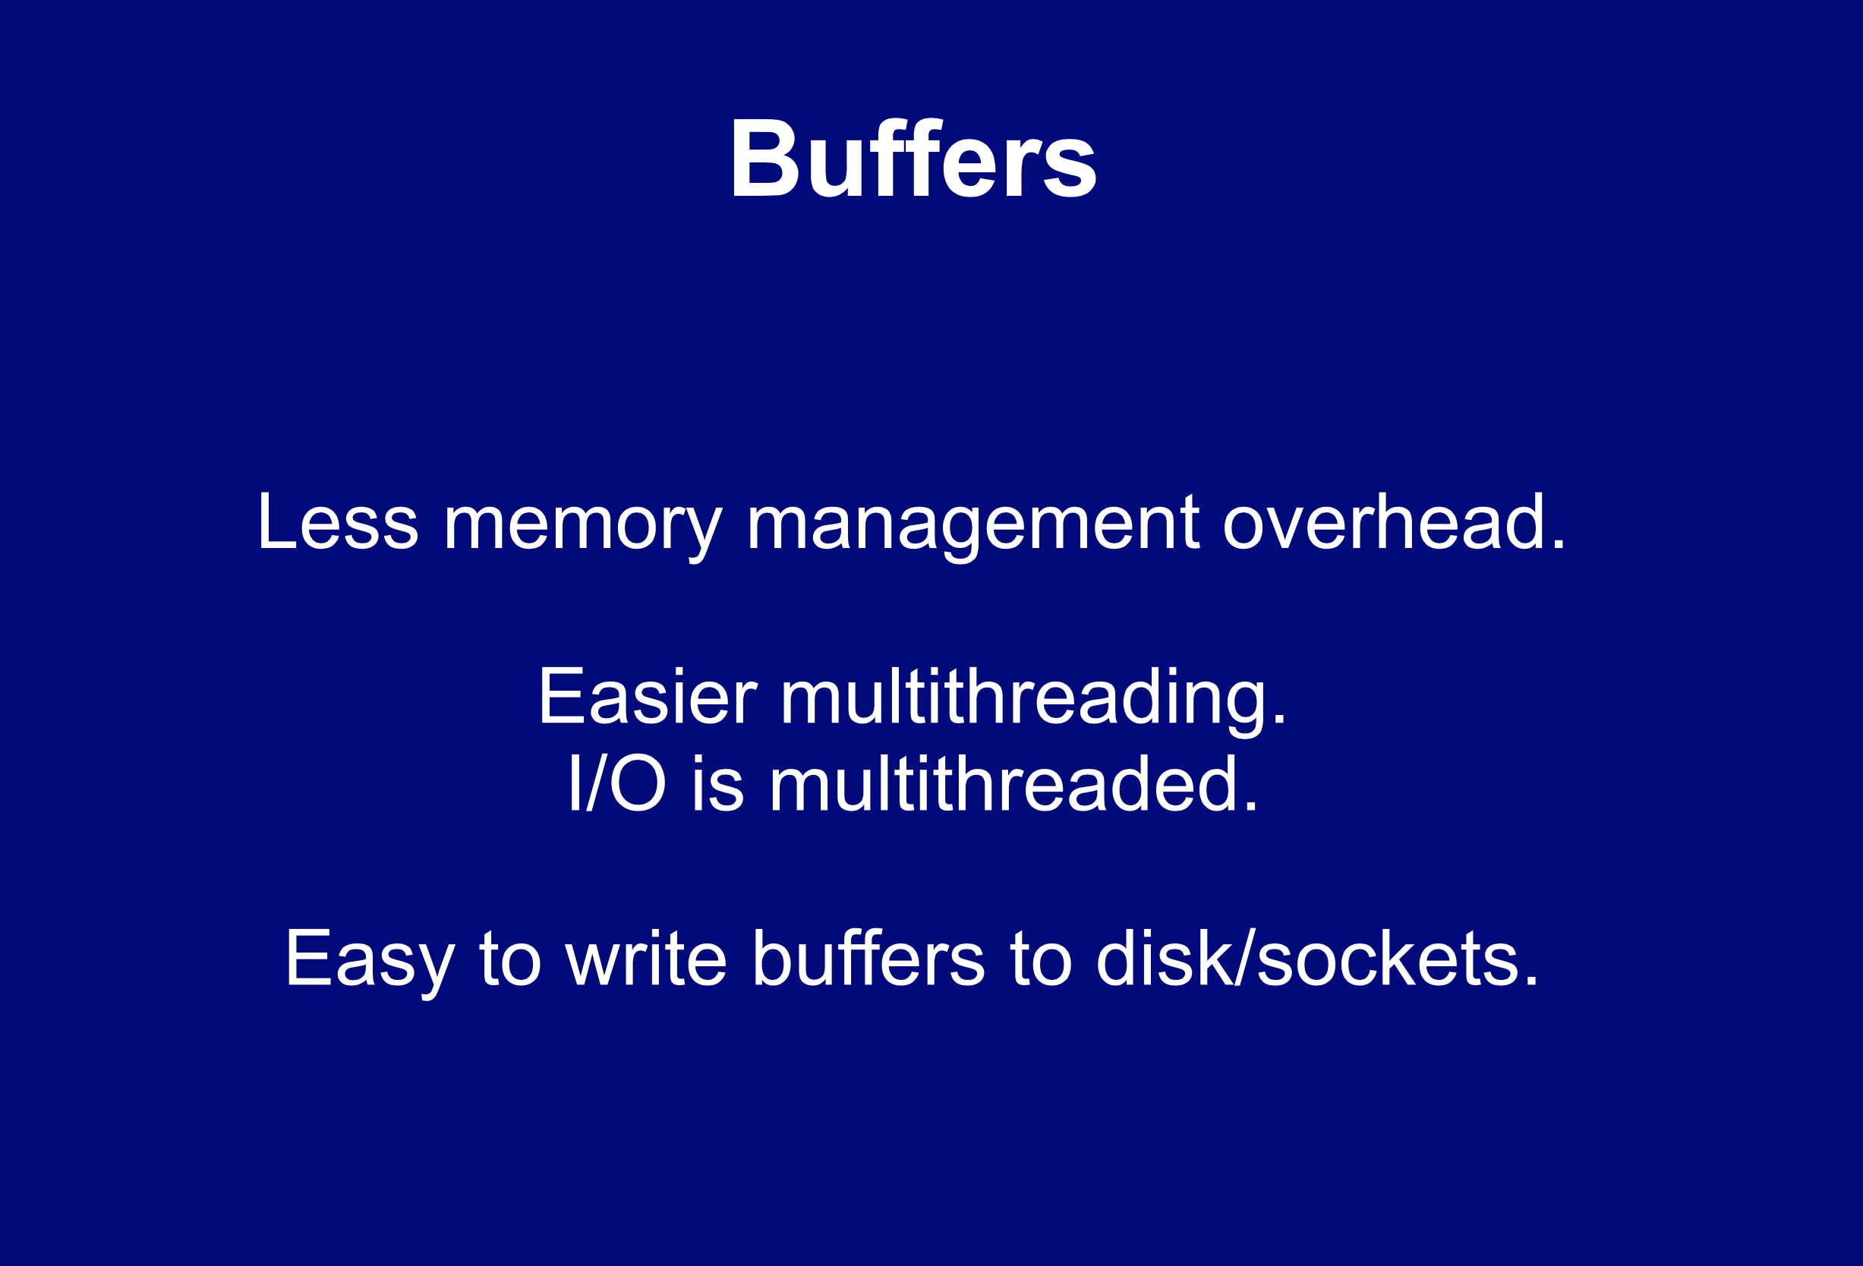

Slide 39
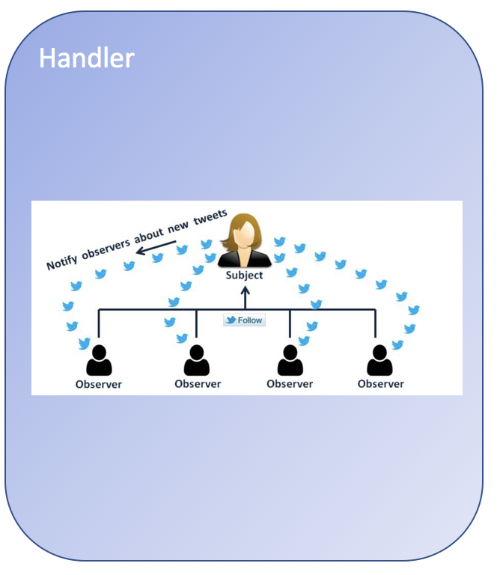
handler
Iterate buffers in the queue
Iterate items in each buffer

Slide 40
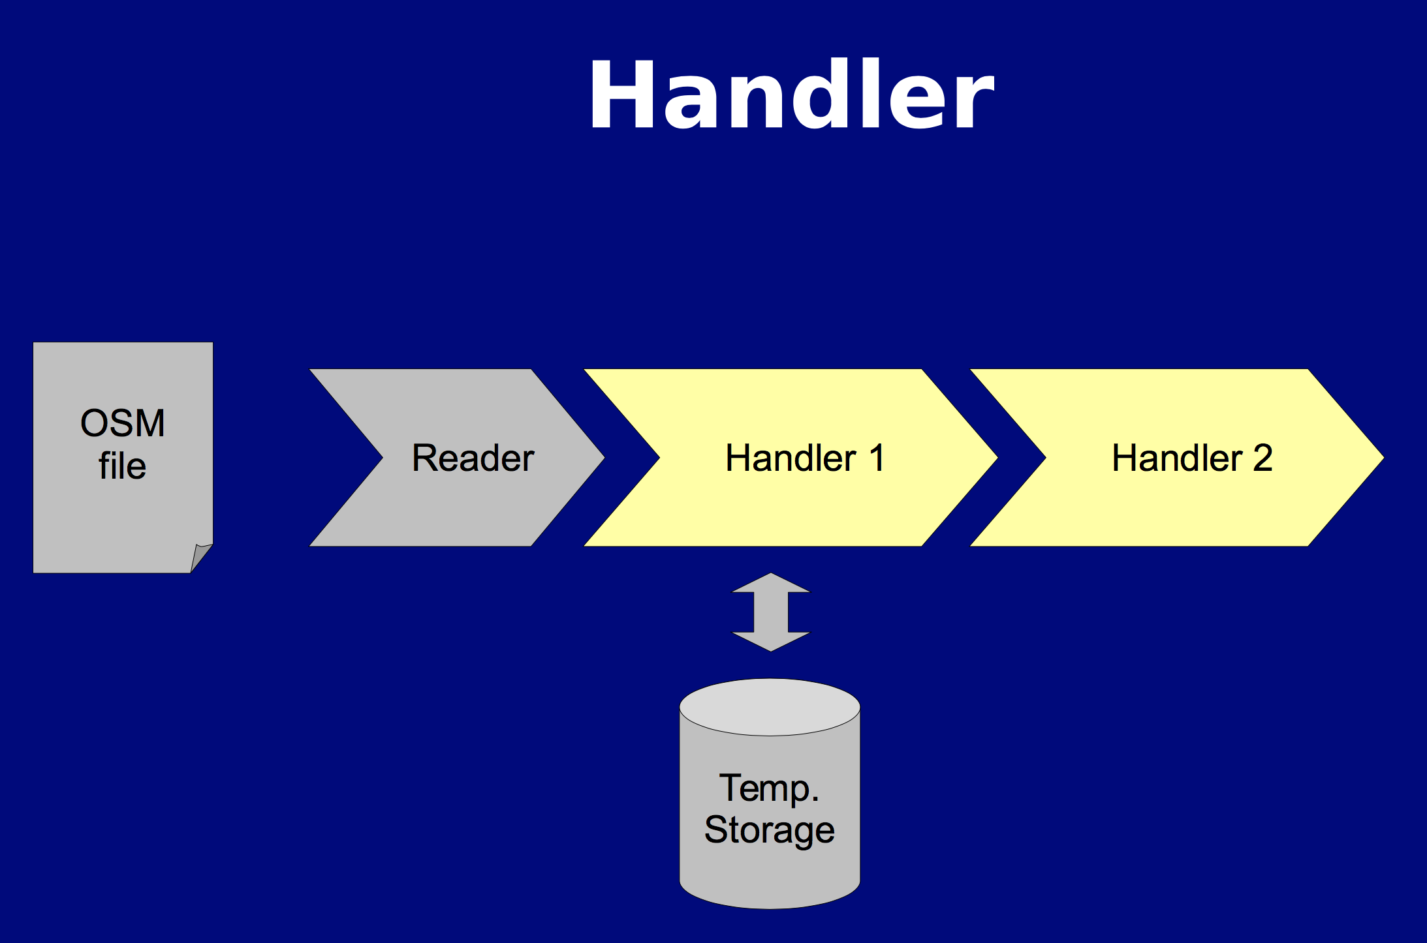

Slide 41
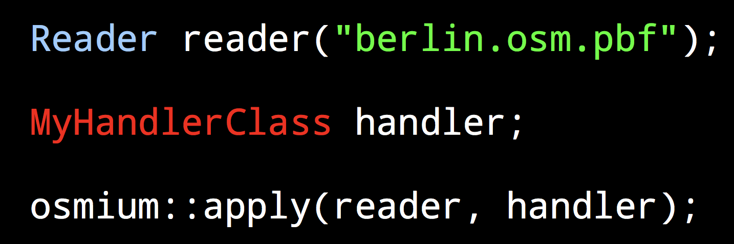

Slide 42
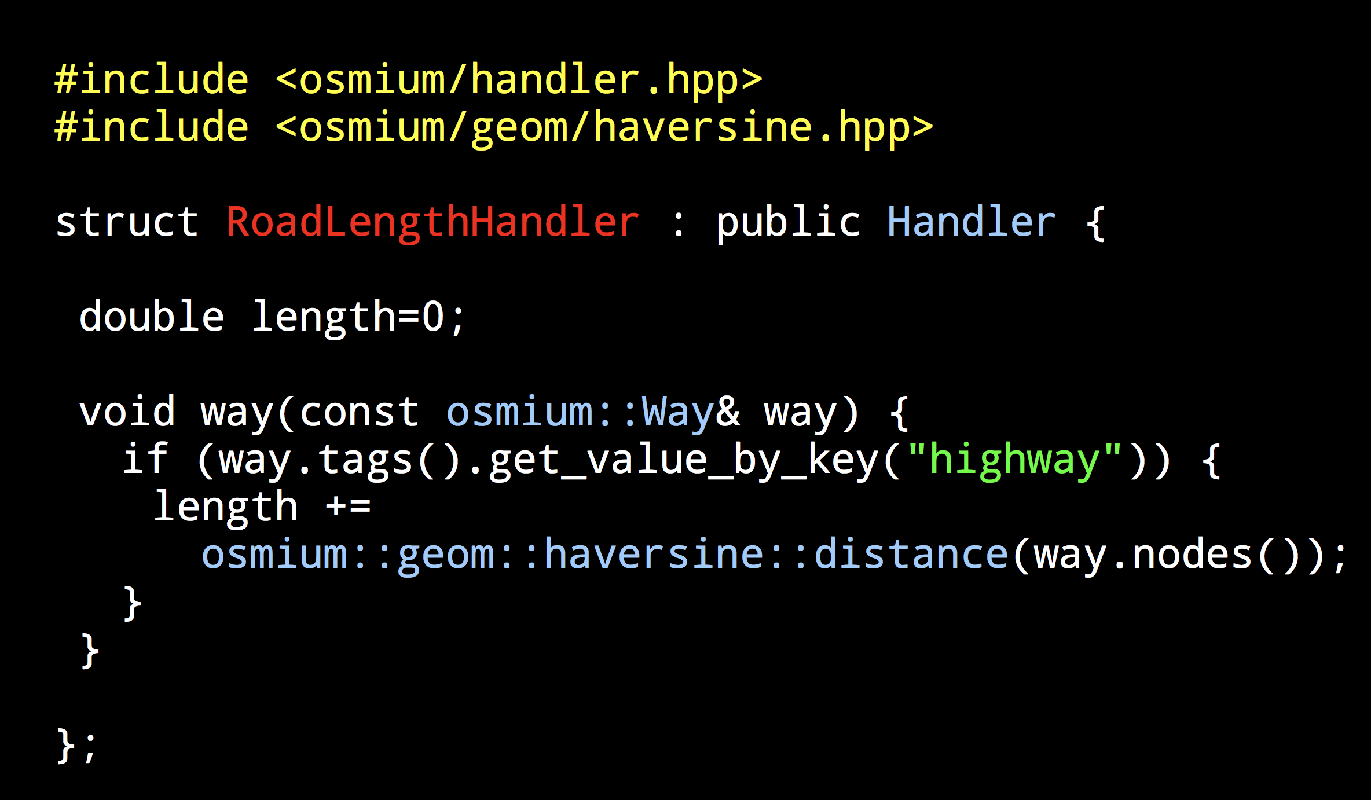

Slide 43
What we could learn
* The pattern of reader->processor->handler
* queue, future, threadpool, buffer
* Divide and conquer

